Slide 1
The Presidency
What Makes a President Great?

Slide 2
Lecture Outline
What Makes a President Great
The Historian’s point of view
C-Span Ranking of the Presidents – Best to Worst
What Makes Leadership Possible
Timing
Personality/Character
Political Intelligence
Political Experience
The Effect of War on Presidencies
Public Opinion and the Presidency
Job Approval Ratings
The Effect of the Economy, War, Scandal
The Rally Effect

Slide 3
What Makes a Great President?
The historian’s view: Great accomplishments
George Washington (1790-1797) – made us believe the American experiment in democracy could survive in a hostile world of monarchies
Thomas Jefferson (1801-1809) – procured the Louisiana Purchase, gave the country a buffer zone against the potential incursions of the Europeans on the frontier
Abraham Lincoln (1861-1865) – ended the institution of slavery and held the union together, proving that democracy could survive internal dissention, even civil war
Franklin Roosevelt (1933-1945) – led us through the Great Depression and to victory in WWII
Ronald Reagan (1981-1989) – revived the American spirit and precipitated the end of the Cold War
Notes:
In the 2000 C-Span poll of leading historians, LBJ (Lyndon Johnson) was ranked the 10th best president in American history. In the 2009 C-Span poll, LBJ ranked 11th.
Lyndon Johnson (1963-1969) – passed Civil Rights and Voting Rights Acts, designed to correct for past discrimination

Slide 4
What Makes a Great President?
Great Accomplishments
Leadership Opportunities
Timing
Personality/
Character
Political
Intelligence
Political
Experience
Notes:
Good Timing – some presidents come to power at a time that is ripe for big changes; there is an old adage: “great crises make great presidents”
Personality/Character – some presidents have the right temperament for the job; some are more credible, giving them more persuasive power
Political Intelligence – some presidents are good politicians; their skills enable them to be accomplished
Political/Wartime Experience – A politician must first be elected before having any opportunity to exhibit leadership…4 of the last 5 presidents were former state governors…many war veterans and a few commanding generals have also been elected president

Slide 5
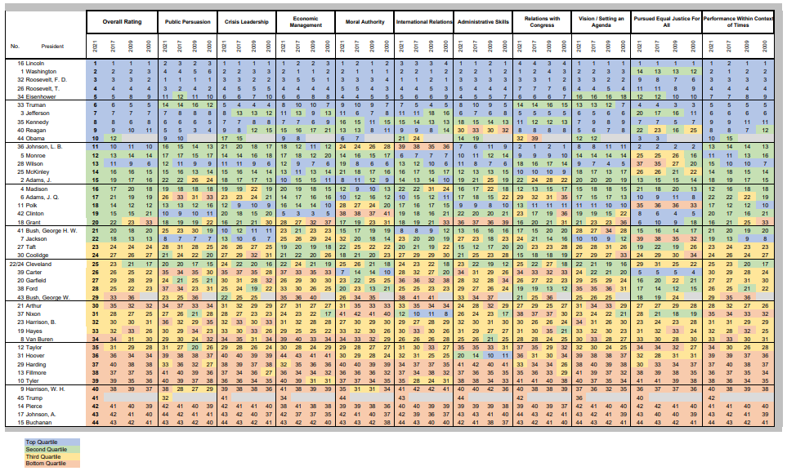
Historians Ranking of Presidents C-Span Rankings of the Presidents (2021) – Best to Worst
Here are the top 10 presidents
Obama ranked 10th
Clinton ranked 19th
Bush43 ranked 29th
Trump ranked 41st
Here are the
bottom 10 presidents
Notes:
See 2021 C-Span poll of 142 historians: https://www.c-span.org/presidentsurvey2021/?page=overall
2021 Survey Tabulations FINAL.xlsx (c-span.org) -- https://static.c-span.org/assets/documents/presidentSurvey/2021-Survey-Results-Category-Rankings.pdf
See 2017 C-Span poll of 91 historians: https://www.c-span.org/presidentsurvey2017/?page=overall
See 2009 C-Span poll of 64 historians: http://legacy.c-span.org/PresidentialSurvey/Overall-Ranking.aspx
2021 Survey
https://static.c-span.org/assets/documents/presidentSurvey/2021+Press+Release.pdf https://www.cnn.com/2021/06/30/politics/presidents-ranking-trump-lincoln-cspan/index.html – Trump is ranked 41 out of 44 presidents. Here are some of the changes from the 2017 survey:
Cut and paste from article above: There could be some good news for Trump in the next survey. Some fellow recent presidents have experienced bumps in their rankings as time has passed ...
As C-SPAN put it:
Barack Obama rose to #10 from his #12 ranking in 2017.
George W. Bush continued his steady incline, now ranking at #29, from #33 in 2017 and #36 in 2009.
Bill Clinton began at #21 in 2000 and held steady at #15 in 2009 and 2017 before declining this cycle to #19.
On President’s Day, 2015, the American Political Science Association, Presidents and Executives Politics Section released a 2014 Survey of 164 political scientists. Obama was ranked 18th. Clinton and Jackson made the top 10 greatest presidents, 8th and 9th respectively; Kennedy was ranked most overrated president at 14th. Reagan was ranked 11th. George W. Bush was ranked 35th of 43.The rankings are different than the C-Span poll of historians (which is shown in the graphic above) For the 2014 Survey of political scientists, see: http://www.washingtonpost.com/blogs/monkey-cage/wp/2015/02/16/new-ranking-of-u-s-presidents-puts-lincoln-1-obama-18-kennedy-judged-most-over-rated/
President Obama modeled his presidency after Franklin Roosevelt (Obama’s domestic agenda is similar to the New Deal and he tried to employ FDR’s “good neighbor” foreign policy) and Abraham Lincoln (Obama brought political opponents, like Hillary Clinton, into his cabinet), so he was gunning for a position in the top 10 of US presidents, and in his first ranking, Obama polled at 12th best president.
Bush43 was ranked as the 7th worst president in 2009 but in 2017 he moved up five spots to 12th worst. If there is any solace for Bush, it would be that Truman (6th best) left office as a disgraced president, just like Bush did, but now historians rank Truman among the greatest presidents. Wilson left as a disgraced president as well, but he too was ranked among the greatest presidents (6th best in the 2000 survey) before falling in more recent polls (13th best in 2021). More on Wilson below.
Wilson has fallen from 6th best in the 2000 survey to 13th best in the 2021 survey probably because Wilson was an extreme racist, even within the context of his time (1913-1921). Wilson was a strong supporter of segregation, unusually strong, again even within the context of the times. After George Floyd was killed by a police officer in May 2020, race has been a highly salient issue, and a very polarizing issue, in American politics. The 2021 survey of historians was completed in the aftermath of George Floyd, and race probably influenced many of the historians polled, and they would be less inclined to rank a president highly who had a bad record on the race or civil rights issue.
Here is an article detailing some of Wilson’s extreme racist sentiment: https://www.vox.com/policy-and-politics/2015/11/20/9766896/woodrow-wilson-racist
Best Presidents:
Many of the historians alive today and conducting this poll of the greatest to worst U.S. presidents are authors on the Cold War era of American history, an era where the U.S. and Soviet Union struggled against each other, each trying to prove its system of government was superior, with America representing democratic capitalism and the Soviet Union representing authoritarian communism. The Soviet Union collapsed into its 15 component countries in 1991, with Russia being the largest and most powerful of the 15, and communism ended with it (except for communism in a few other countries, e.g., China, Vietnam, North Korea, Cuba). There may be a bias among historians today because they tend to emphasize the importance of the Cold War over other parts of American history. In 2017, five (5) of the presidents ranked in the top 10 greatest presidents were president during the Cold War: Truman, Eisenhower, Kennedy, Reagan, and LBJ.
Worst Presidents:
Four (4) out of the bottom 10 worst presidents were on the wrong side of history on the slavery issue. These would include Filmore, Pierce, Andrew Johnson, and Buchanan.
Buchanan -- failed to adequately address slavery issue...Dec. 1860 quote: “All that is necessary [to settle the slavery question]...and all for which the slave states have contended, is to be let alone and permitted to manage their domestic institutions in their own way. As sovereign states, they, and they alone, are responsible before God and the world for the slavery existing among them. For this the people of the North are not more responsible and have no more right to interfere than with similar institutions in Russia and Brazil.” He also believed secession was unconstitutional. 8 states seceded before Buchanan left office.
Buchanan also failed to resolve the Kansas issue...he supported the LeCompton Constitution admitting Kansas as a slave state...the LeCompton Constitution lost in two referendums of the Kansan voters. Stephen Douglas demanded a vote, forcing the referendums. Still, the referendum results were ignored and Kansas entered the union as a slave state.
Buchanan’s view of state sovereignty as it applied to the American states in 1860 is similar to the way the world views state sovereignty for countries today. The norm in the world today is that it is only permissible to violate the sovereign borders of another country if there is a multilateral coalition of countries that intervene to stop gross human rights violations. Obviously, slavery was a gross human rights violation, but the concept of state sovereignty was strong in the American states at that time…and Lincoln changed that. Our concept of state sovereignty for the American states changed after the Civil War, though states have still resisted federal intervention, based on the sovereign borders doctrine (or what we call state’s rights in America). And internationally, the norm to protect human rights is slowly chipping away at state sovereignty for countries whose leaders routinely kill their own people.
On slavery, President Buchanan (1857-1861) believed the government could do nothing about slavery in the southern states. There was no 14th Amendment at that time, which gave the federal government the power to impose civil liberties in the Bill of Rights on the states. Prior to the 14th amendment, the Bill of Rights only applied to the federal government, so legally and constitutionally, Buchanan was right—a constitutional amendment was necessary to end slavery (the 13th Amendment – 1865). Of course, Buchanan was morally wrong because slavery was a gross human rights violation that goes against the concept of individual rights.
Pierce -- viewed as wanting to expand slavery into Kansas and potentially to Cuba, which the US tried to purchase in the 1850s.
Fillmore -- support the Compromise of 1850, which included the Fugitive Slave Law – a law that considered slaves as property (also defined Texas borders, gave Texas $10 million for debts)
Buchanan, Pierce and Fillmore were on the wrong side of history. Each failed to make any attempt to end slavery. Historians have since condemned these presidents.
Harding and Grant endured many scandals, viewed as having corrupt administrations. Though Grant gets a bad wrap. He sent US troops to South Carolina to wipe out the Ku Klux Klan in 1871. The effort set back the KKK for 20 years, but the KKK eventually recovered and dominated South Carolina politics for decades. Grant was condemned for using US troops because the federal government was never supposed to use military power against the states; rather, the federal government was suppose to respect federalism, the division of power between the national government and state governments. At the time, Grant’s sending troops to South Carolina was viewed as a step toward dictatorship; it was even seen that way in the North.
Tyler vetoed major legislation passed by his own party in Congress. The party (Whig Party) then expelled Tyler. He was a president without the backing of a political party, which made it impossible for Tyler to govern effectively.
Herbert Hoover was unable to adequately address the Great Depression, which began under his tenure.
Chester Arthur was a party hack, who worked his way up through the Republican Party by doing favors and distributing patronage as the head of the New York Port Authority.
William Henry Harrison died after being in office for only one month. So, he didn’t do anything. But in his defense, he didn’t have time to do anything.
Ruthford B. Hayes endured a disputed election (1876), which tainted the authority of his administration. He oversaw the controversial military withdrawal from the South, which didn’t please his own party and it came too late (12 years after the Civil War) to please the Democratic Party. In 1876, he was nominated by his party on the 7th ballot, so he was not a clear favorite among the party bosses within the Republican Party. Given this, he promised only to serve one term, which makes him look weak in the eyes of historians.

Slide 6
Presidential Leadership 18th and 19th Century
What makes a great accomplishment?
Leadership – requires the ability to take big risks to try to change the direction of the country
Risk-taking usually comes with a high price because those opposed to the president are threatened by big changes
Examples of 18th and 19th Century Leadership
The Jay Treaty (1795) – George Washington formed an economic alliance with Britain
The price: The country split into 2 factions, pro-French and pro-British…John Adams, the next president, took the brunt of the fallout, fought a Quasi War with France (1798-1799)
Resolution of the Nullification Crisis (1832) – Jackson threatened to send troops to South Carolina…federal law supersedes state law
The price: Jackson hated vehemently; an opposition party to Jackson formed (the Whig Party)
Emancipation of the slaves (1863) – Lincoln sent a message: the South will never return to its old ways
The price: Lincoln assassinated...the South became solidly Democratic for more than 100 years, hated Lincoln’s Republican Party
Notes:
The Nullification Crisis (1832) involved tariffs on imported goods. Congress passed the “Tariff of Abomination” (i.e., higher taxes on imported goods from other countries). Higher tariffs hurt the agricultural South, which wanted to sell farm products overseas and to buy tools for plowing fields from foreign countries, from which they could purchase cheaper than from the North. Higher tariffs made foreign products more expensive, and US agricultural products would be more expensive to export because other countries would raise their import taxes in response to the US raising tariffs. Jackson agreed that taxes had been raised too high, and he promised to lower them over the course of 9 years, but he insisted that federal law superseded state law, and if South Carolina refused to collect the added taxes on goods that came into the state from other countries, then Jackson threatened to send in federal troops to seize the customs houses in South Carolina. The southern states viewed the threat as that of a dictator. Federal troops were never supposed to be used against a state; this is what the anti-federalists feared at the time of the ratification of the Constitution (40+ years earlier). As a consequence, a new political party formed in opposition to Andrew Jackson. Jackson was America’s first intensely polarizing president. (In recent American history, we have had a number of intensely polarizing presidents: Nixon, Reagan, Bush41 (in the first 2 years), Clinton, Bush43 (the son), Obama, and Trump)
Another example of leadership that came with a heavy price:
Adherence to the Gold Standard (1893) -- Grover Cleveland chose to fight inflation, rejected the proposal to add silver to the gold standard…Cleveland’s political career was ruined; Cleveland’s actions divided the Democratic party; it split into 2 factions, which weakened the party and allowed Republicans to dominate politics for 30 years. But looking back, we would probably conclude that fighting inflation was the right thing to do.

Slide 7
Presidential Leadership 20th Century
Examples of 20th Century Leadership
14 Points to End WWI (1919) – Wilson promoted self-determination (i.e., an end to imperialism and colonialism), free trade, and an international governing body (the League of Nations)
The price: Wilson destroyed politically at home, Treaty of Versailles rejected by US Senate, Europe rejected proposal to end colonialism, League of Nations failed, WWII ensued
Civil Rights Act (1965) – LBJ (Lyndon B. Johnson) pushed through civil rights over the objections of conservative Democrats
The price: LBJ split the democratic party; over the next 25 years, conservative democrats switched to the Republican Party
Reducing the Size of Government (1981) – Reagan cut $35 billion in 1981, targeted failing housing projects
The price: Reagan accused of being mean and hateful to the poor, Republicans have since rarely tried to cut spending
Notes:
Some more modern examples of leadership that came with a price:
War on Terrorism/War in Iraq -- Bush43 decided to fight war, not to treat 9/11 as a police action. Bush caught hell for allegedly disregarding the views of US allies and for making up the intelligence on WMDs in Iraq. He survived reelection (2004), but the price was this. Bush’s unpopularity, in part due to the Iraq War and his other controversial war policies (e.g., domestic spying, detainment of terror suspects, etc.), was largely responsible for bringing Democrats to power in Congress (2007) and to the White House (2009).
Health Care Reform (2010) – At the time health care reform passed, 40% supported it and 50% opposed it. Going against public opinion is always a risk. Coming into 2010, it appeared that President Obama’s health care initiative was dead and would not become law, but he had majorities in Congress and decided to put health care back on the agenda. His second effort paid off, and Congress passed health care reform in March 2010 (the Senate used a controversial budgetary law to avoid a filibuster to get it to pass the Senate). But there was a gigantic backlash to health care reform—it sparked the Tea Party Movement, which then was instrumental in helping Republicans win the largest victory in elections for the U.S. House since 1948. The political price that Obama has paid for health care reform has been the loss of a Democratic majority in the U.S. House and, in later 2014, the loss of a Democratic majority in the U.S. Senate.
There are examples of leadership through which the president did not suffer greatly:
WWII -- FDR’s lend-lease program began the process of leading us into WWII. FDR was accused of trying to take America to war, but he didn’t suffer too much politically
Confrontation with Soviet Union (1981-1985) -- Reagan was accused of being reckless, of trying to start a war, but eventually Reagan achieved peaceful relations with the Soviet Union.

Slide 8
Timing and Leadership
Timing produces leadership opportunities
Opportunities for changing the direction of the country on social, economic and foreign policy tend to follow presidents who are perceived to have failed
Jefferson (1801-1809) followed John Adams (failed president)
Jackson (1829-1837) followed J.Q. Adams (failed president)
Lincoln (1861-1865) followed a series of failed presidents
FDR (1933-1945) followed Herbert Hoover (failed president)
Reagan (1981-1989) followed Jimmy Carter (failed president)
Obama (2009-2017) followed George W. Bush (failed president)
Biden (2021-present) followed Donald Trump (failed president) (???)
The small v. big government struggle is not new in U.S. history
Jefferson, Jackson, Reagan took advantage of their leadership opportunities to push for smaller government
Lincoln, FDR, Obama used their leadership opportunities to push for a greater role for government, and Biden too (presuming he benefits from good timing)
Notes:
The “window of opportunity” for leadership that comes with good timing has become smaller over time, meaning that presidents of the present day (e.g., Biden and Obama) have a shorter amount of time to get significant policy change through Congress than presidents of the past (e.g., Jefferson and Jackson). The reason for this is because as our political system evolves, more power centers form that the president cannot control. Trump really didn’t benefit from “good timing” because Obama (Trump’s predecessor) left office being perceived as a successful president, rather than a failed president, but in Trump’s term, Twitter became a major player in politics, and Trump used it to reach almost 100 million followers. At the end of Trump’s term, at the time of the Capitol riots (Jan. 6, 2021), Twitter permanently banned Trump from its platform. Twitter became a power center in our political system that pushed back against the president.
Reagan had one good year as president, during which he was able to work through a large tax cut through Congress. Then for the last 7 years of his presidency, he had to fight to keep what he had put in place in his first year in office. Similarly, Obama had a good 1 ½ years as president, in which he got through Obamacare, and then he had to fight the last 6 ½ years of his presidency to keep Obamacare in place. So, the “timing” opportunity of the modern presidents is limited nowadays.
Joe Biden and Donald Trump
President Trump’s supporters certainly would not view him as a failure. He got a large tax cut through Congress; he got three (3) nominees to the US Supreme Court confirmed, and 100s of conservative judges in the lower federal courts; he cut regulations on the economy; he made progress on building a border wall on the US-Mexico border; he had no foreign policy crises in his 4 years in office; he struck peace/cooperation deals between Israel and four (4) Arab countries; he exhibited independence from existing norms, such as by withdrawing America from the peace deal with Iran, from the Paris Climate Change agreement, and from the World Health Organization after it covered for China during the coronavirus, and he fought back against the media, labeling his detractors in the media, “fake news,” in a way that Nixon and Reagan never could…and more. So, Trump supporters see all of these as consequential accomplishments. Still, these accomplishments get drowned out in the media by the negative press that Trump received for being so bombastic with his Twitter rants and confrontational with reporters/the media and for being an alleged racist/white supremacist and for being impeached twice and for not winning a second term in office, as well as for not handling the coronavirus as well as a president with a more reassuring personality could have. All of these critiques and more give the perception that Trump left office as a failed president, and this should give Biden a significant leadership opportunity for at least the first year of his presidency.
It is possible that I have characterized Biden’s “good timing” wrongly. Bill Clinton followed George H.W. Bush, who was a one-term president, and also considered to have been, to some degree, a failed president. But Bill Clinton did not have a significant leadership opportunity at the beginning of his presidency. So, Biden might be in the same situation that Clinton was. I will reassess Biden’s “timing” as president after the first year of his administration.
History is always kinder to the “failed” presidents. Trump could come back in the eyes of history, particularly if he runs again and wins, like Grover Cleveland did in the late 1800s, winning two non-consecutive terms as president. Also, if any of Trump’s policies or his exhibitions of independence of the norms of presidential behavior turn out to set precedents for the future.
Barack Obama and George W Bush
Barack Obama came to power in a context very similar to Jefferson, Jackson, Lincoln, FDR, and Reagan. The 2009 C-Span poll ranked Bush as the 7th worst president in American history (he moved up 5 spots to 12th worst in the 2017 c-span poll). Given that historians so far consider Bush43 to be a failed president, this created a leadership opportunity for Obama. Power is more diffuse today than it was in Jefferson’s and Jackson’s time, consequently, Obama has faced fierce resistance from the Tea Party movement and other power centers that did not exist or were not as well formed earlier in our nation’s history. Reagan faced much more resistance to his policy agenda than FDR, Jackson, and Jefferson. Though Reagan came to power in a context ripe for big changes, his reconstruction of the political system was incomplete. Obama had similar results as Reagan, an incomplete reconstruction of the political system.
50 years from now, historians may have a different view of the Bush presidency. Bush had some successes, such as pushing through his agenda of tax cuts. In the long run, if Iraq stabilizes and functions as a peaceful country in this world (and does not sponsor terrorism), then Iraq will look a lot better in the eyes of history. If Iraq goes the other way, and a dictatorship takes over at some point in the future, one that is hostile to America, then Bush will be viewed like he is today by many people, as a failed president. The outcome of the war on terrorism is also important. If America comes out this okay, then historians will most likely look back at Bush’s efforts in the war on terrorism favorably. The civil liberty violations that occurred in the Bush years will likely be forgotten by history, just as civil liberty violations under past wartime presidents have been forgotten.
Democrats were able to capitalize on the “anything but Bush” sentiment in the country in 2008. Democrats won larger majorities in both chambers of Congress, and Obama won the presidency. Obama hopes historians will someday include him among Lincoln and FDR—presidents who used their leadership opportunities to expand the role of government in society.
Though Obama had plenty of critics who believed his presidency was a disaster (e.g., because of Obamacare and a softer foreign policy), historians do not consider Obama to be a failed president, so having followed Obama, Trump faced much resistance as president. Trump is more like Clinton, who straddled the fence between what it means to be a Republican and Democrat.
Presidents who benefitted from a failed predecessor:
Jefferson (1801-1809) – pushed for smaller government (lower taxes, smaller military) and a more aggressive posture toward Great Britain
The Failed President: John Adams, who had raised taxes, violated civil liberties, and split his party in Quasi-war w/ France
Jackson (1829-1837) – pushed for smaller government (lower tariff rates, elimination of national bank, less federal involvement in internal improvements (roads, bridges, canals))
The Failed President: J.Q. Adams, who was discredited by the election controversy of 1824
Lincoln (1861-1865) -- changed social order (abolition of slavery, rhetorical commitment to civil rights) and pushed for bigger government (land grants for railroads, higher tariffs to protect business)
The Failed Presidencies: Democrats failed to address slavery
Franklin Roosevelt (1933-1945) – pushed for bigger government (higher taxes (income & tariff rates), greater regulation of business) and a more multilateral foreign policy (America to take a more active role in the world and to work with international bodies)
The Failed President: Hoover failed to address depression, despite his 1932 initiatives for more government relief programs
Ronald Reagan (1981-1989).– pushed for smaller government (lower taxes (income & tariff rates), less regulation of business) and an aggressive posture toward Soviet Union in Cold War
The Failed President: Jimmy Carter, who could not solve the country’s economic woes and who was embroiled in the Iran Hostage Crisis
Barack Obama (2009-present) – has pushed for bigger government (health care reform, reforms of finance sector of economy, higher taxes on the wealthy + excise taxes on many products and services) and a limited good-neighbor foreign policy
The Failed President: George W Bush, who took the country to war in Iraq, which as of now, is considered to have been a disaster
More on successful and failed presidencies:
Though committed to smaller government in rhetoric, TJ used the strong arm of government to impose an embargo on U.S. trade and non-importation restrictions with Britain
Why was Adams a failed president? Property tax very unpopular, Alien and Sedition Acts unpopular, Quasi-war with France split the party
A drift toward bigger government occurred between TJ and Jackson. The Jacksonians believed that the Republican party had lost its way and needed an adjustment.
Lincoln egregiously violated civil liberties during the Civil War (jailing of Democrats in North for duration of war). Lincoln’s Republican party was pro-business (not necessarily pro-capitalist) but also liberal on social issues
Hoover advocated volunteerism and local initiative in the beginning but later reversed course. The RFC was created in January 1932 and amended in July (1932) under the Emergency Relief and Reconstruction Act...government would essentially take over financial institutions and railroads...RFC would give direct loans to states for relief based on need; also funds for public works and to institutions committed to stabilizing agricultural prices...Federal Reserve to give loans to business
Carter appointed Paul Volker as chairman of the federal reserve; Volker managed the monetary supply to fight inflation...For 40 years, Democratic monetary policy had been to use spending to fight unemployment; the new Fed policy was more conservative than Carter had hoped for, but the Fed is an independent executive agency and he couldn’t control it.

Slide 9
Presidential Personality/Character A Reassuring/Comforting Personality
There is something about a reassuring (or comforting) personality
Restoration of Sound Banking (1933) – FDR averted a run on the banks in 1933 by assuring the public that government would guarantee bank deposits
FDR’s comforting personality calmed the public and saved the banking system
Resurgence of American Pride (1980s) – Reagan made America proud again at a time when it appeared that the US was becoming a 3rd rate economic power
Japan and W. Germany perceived as #1 and #2 (This was never true)
Reagan’s optimism had a positive psychological effect on the public, and his promise of deregulation of the economy instilled confidence in the business community
Reassurance about a Sluggish Economy (2012) – Obama’s reelection challenge was to calm the public about America’s economic future—most presidents are ruined by a recession
Notes:
The Trump Influence on the Stock Market
As soon as Trump won the presidency, during the transition when Obama was still president, the stock market soared. Trump has since taken credit for the increase in stock values, claiming that the financial markets are more comfortable with what they expect from him than they would have been had Hillary Clinton won the presidency. If there is truth to this, then Trump has had a similar affect on the psychology of the public as FDR, Reagan, and Obama.
Differences between FDR, Reagan, Obama v. Bush (the father)
Contrast FDR, Reagan, and Obama to Bush41 (the father). Bush41 failed to reassure the public to the fact that the economy was actually growing in 1992 (the perception was that the economy was in recession). Candidate Clinton portrayed the 1992 economy as the worst in 50 years. The economy was growing during the presidential election campaign of 1992, but official economic figures are not calculated until 3 months after the fact (it takes a while for government economists to crunch the numbers). Consequently, the evidence of economic growth during the campaign was not released until Feb 1993, which was too late for Bush41. Whatever “it” is about having a reassuring personality, Bush41 (the father) did not have “it.”
Business Stability: Reagan v. FDR and Obama
Regarding the business community, there is an interesting contrast between Reagan on the one side and FDR and Obama on the other. Reagan sent a welcomed message to the business community: “I will cut your taxes and roll-back unnecessary rules (regulations) on your businesses, or at the very least, your taxes will not go up nor will there be more regulations—the time to build your businesses is now.” Business people want to be able to reasonably predict their costs in the near future (5 to 10 years out), and if taxes and regulations remain stable (or are reduced), then business people feel more comfortable borrowing money, investing in their businesses and creating jobs. But business is nervous under an FDR or Obama, which are presidencies that put a new paradigm in place (FDR’s was the “New Deal”, and Obama’s is health care reform and Wall Street reform), and these new paradigms create a lot of instability for business, at least for a few years. Business tends to freeze to ride out the storm. This has happened in recent years—there is $2 trillion in private money sitting in banks not being invested in the economy, reason being that business people are nervous about change and cannot reasonably predict their costs right now. Once things settle, business will adjust and figure out how to succeed. The New Deal economic reforms set the economy back for more than a decade, but once business adjusted, America experienced high-levels of economic growth in the 1950s and 1960s.
Bush’s (the son) Attempt at Psychological Comforting
Bush43 tried to avert a collapse of the financial system in the US (2008) by having the government essentially takeover the home mortgage and insurance businesses. In September 2008, the federal government took over Fannie Mae and Freddie Mac (two gigantic companies in the home loan business) and AIG (a huge insurance company). The goal of these takeovers was to prevent the instability in our financial system that would have occurred had the government not stepped in. In other words, Bush wanted to calm the fears of those who invest in the American economy. Bush didn’t have the kind of reassuring personality that FDR and Reagan had, but his actions were designed to have the same effect on the public. Bush’s actions did not inspire confidence in the financial sector, nor has Obama’s (given that $2 trillion sits in banks, not being invested in the economy). The year 2014, however, was the break-even year on job creation, meaning that all the jobs lost during the Great Recession have been gained back, as of 2014.
(see http://data.bls.gov/timeseries/LNS14000000). Obama’s 2009 stimulus package did not spark the job creation for which Obama had originally hoped.
Obama’s Reassuring Personality
Obama had a cool about him that helped him manage public opinion regarding his handling of the economy during the 2012 presidential election cycle. Obama was successful in convincing the public that the state of the economy was akin to the Great Depression when he first took office and that he was working the problem and needed more time to solve it. Usually, a sitting president is punished by the voters in the next election for a bad economy, but Obama neutralized any potentially negative effects a sluggish economy had on his reelection prospects. Other influences were in play as well, such as media coverage favorable to Obama’s position. Still, in the end, on Election Day 2012, exit polls showed that 53% of the public blamed the Bush administration for our economic woes, compared to 38% who blamed Obama.
In addition to neutralizing the issue of the economy, the Obama campaign was successful in impugning Mitt Romney’s character in 2012, painting Romney as a candidate with something to hide (for not releasing years of tax returns) and for being so rich and privileged that he could not relate to the average American. Adjusting for inflation and the size of the economy, had Mitt Romney won the election, he would have been our country’s second wealthiest president (George Washington is our nation’s wealthiest president to date).
In Dec 2008, the federal government reported that the economy had been in recession for one year, beginning in Dec. 2007. Throughout 2008, many economic analysts assumed the economy was in recession, but that was not known for sure until Dec. 2008.

Slide 10
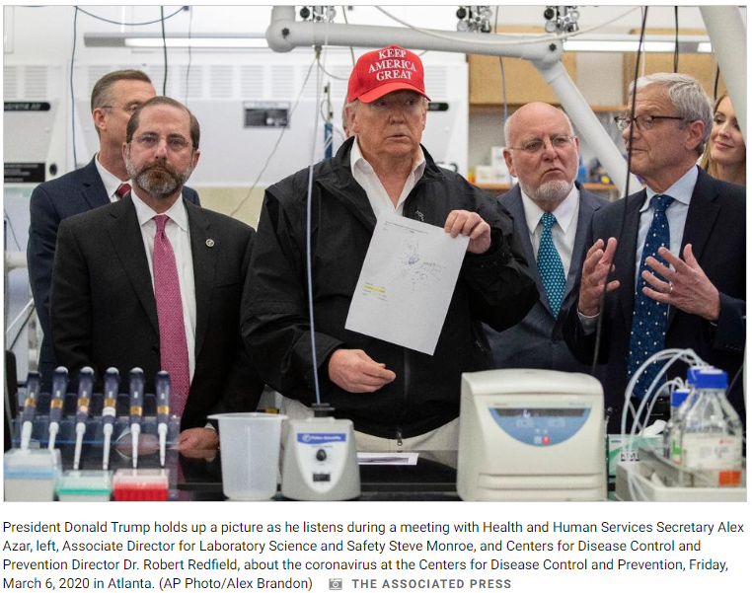
Presidential Personality/Character A Reassuring/Comforting Personality: Trump in Contrast
As a confrontational and partisan fighter, Trump was not a president who had a reassuring or comforting effect on the public
A crisis leader is the type that can calm and reassure a public prone to panic during a crisis, and Trump is not that
Trump is a man of action, one who gets things done, being a former real estate developer, and “operation warp speed” helped eliminate “red tape” so that drug companies could produce a coronavirus vaccine in record time
But in a crisis, a president needs to be able to calm the public, and Trump could not do that during the coronavirus pandemic
Trump visited the Centers for Disease Control (CDC) on 6 March 2020, with his public health team, for a briefing on the seriousness of the novel coronavirus and the coming pandemic. Wearing a “Make America Great Again” hat was not a serious look for Trump (it would be appropriate to wear that hat at a campaign rally). Trump viewed the virus as a threat to his reelection, which it was, but as our president, he needed to prep the country for the coming pandemic and to calm the public
Notes:
Trump did not reflect the seriousness of the Coronavirus when the public first became aware of it. Wearing a MAGA hat is appropriate in some contexts, e.g., at a campaign rally, but wearing a MAGA hat did not project the gravity of a coming pandemic when Trump was getting informed about how deadly the virus might become. In September 2020, Bob Woodward published the book, “Rage,” in which Trump revealed that he intentionally downplayed the severity of COVID-19 in the March 2020 timeframe. Trump wanted to avert a panic among the public, which is understandable, but Woodward portrayed Trump as being derelict in his duty to inform the public about the truth of the coming pandemic.
Early in the pandemic, Dr. Fauci advised the public not to wear masks. Later, he admitted that he did so to avert a run on masks, because he believed there was a shortage of Personal Protective Equipment (PPE), including a shortage of masks, and he wanted the supply of masks to be available for frontline health care workers. But the difference between Fauci and Trump is that Fauci was not running for president in 2020.
Trump’s Coronavirus Gambit
Being a real estate tycoon, Trump is a man of action; ultimately, skyscrapers and resorts are built (in contrast to the typical politician, who just talks and talks and talks but rarely delivers anything). So, during the coronavirus pandemic, Trump fell back on this strength, using his powers as president to remove bureaucratic “red tape” so that the drug companies could produce a vaccine much faster than under normal circumstances. The initiative was called “operation warp speed.” Trump sensed that the devastating effects of the coronavirus on our economy, not to mention the mounting death toll, could result in an Election Day loss, and since he was not a crisis leader, meaning he does not have a calming effect on a public that is prone to panic during a crisis, Trump’s political survival depended on getting an effective vaccine to the American people, which would allow us to return to normal (and end the anxiety amongst the voting public). It was a race against time, and Trump ran out of time. Just 2 weeks after the election, Moderno and Pfiser, two drug companies, reported that their novel coronavirus vaccines had been tested and that they were 95% effective. Trump needed this news a month before the election, but it didn’t happen until after the election.

Slide 11
Presidential Personality/Character A Credible Threat
A “tough” reputation gives a president a credible threat
End of Korean War (1953) – Eisenhower threatened to use nuclear weapons to end the Korean War
Was Eisenhower’s threat for real? Probably not. It is unlikely Ike would have used nuclear weapons
Why did the North Koreans take the threat seriously?
Eisenhower’s threat was highly credible because, as Supreme Allied Commander during WWII, Ike ordered saturation bombing of German cities (in particular, Dresdin), killing women and children as well as German troops
Ike demonstrated a willingness to order massive destruction
Libya’s Concessions on WMDs (2003) – Gaddafi agreed to end his WMD program
Why would Gaddafi volunteer this concession? Perhaps he viewed Bush as a credible threat to his power, feared an American invasion
Gaddafi’s view: America attacked Iraq in 1991, then again in 2003...America bombed Libya in 1986; would it happen again?
Notes:
Eisenhower and Bush43 were a lot alike. Neither was highly principled on domestic issues, but both viewed national security as their primary responsibility. Both took their respective conflicts, the Cold War and the War on Terror, very seriously.
Bush and Quadafi – the U.S. had no plans to invade Libya in 2003, but the British played on Qaddafi’s psyche by telling him there was a planned invasion. Not wanting to lose his country, Qaddafi decided to deal with the U.S. on WMDs. In other words, Qaddafi allowed-in weapons inspectors and he stopped pursuing WMDs. This, however, made him more vulnerable to his internal opposition, which was bold enough by 2011 to make a move on Qaddafi. With the help of a NATO air (bombing) campaign, rebels in Libya overthrew Qaddafi, executing him immediately after finding him hiding in a sewer pipe.
Biden Biden has sort of a “tough guy” way about him, at least in rhetoric. For instance, when running against Trump for president, he said he wished he were back in high school so that he could take Trump behind the bleachers and beat the hell out of him. This kind of rhetoric implies to me that Biden might engage in the same kind of rhetoric against our adversaries overseas, should he want to deter an adversary from making an aggressive move in the world. As of Feb. 2021, Biden has emphasized that he wants to reengage in diplomacy (implying that Trump did not engage in diplomacy), so Biden has taken a less confrontational stand very early in his presidency. Still, I think it is in Biden’s nature to issue threats and implied threats.
Trump
Issuing threats, implied and direct, came naturally to Donald Trump, so Trump shares this policy preference with many past presidents, including the two profiled on the slide (Eisenhower and Bush43). Early in his term, Trump wanted an agreement with North Korea (NK), to eliminate NK’s threat of being able hit Guam and mainland America with a nuclear-tipped missile (NK’s missile technology is improving, meaning its missiles can travel farther and farther, and at some point it could hit America with a missile). Trump threatened NK with devastation the “likes of which the world has never seen” if NK refused to enter negotiations with the U.S. over its nuclear missile program, and NK immediately complied. Trump then changed tact after he had met with Kim Jong Un (the dictator of NK), telling the media that he and Kim had “fallen in love” and really understood each other. Trump’s softer tact didn’t seem to work as well after that because Kim refused to sign any agreement with the U.S. for the remainder of Trump’s term in office, and NK continues to develop its nuclear weapons program.
Still, remarkably, Trump had no serious foreign policy crises during his presidency. The world was surprisingly quiet. He finished the job against ISIS in Iraq, essentially eliminating ISIS from the region, and he bombed Syria a couple of times (for the leader’s (Asad) use of chemical weapons against his own people in the Syrian civil war, which began in 2011), but aside from those engagements, Trump averted any major foreign policy entanglements. It is possible that our adversaries were reluctant to test Trump because Trump came across as a “loose cannon” (e.g., an unstable leader who just might order a massive attack on a whim).
Obama
In most cases, Obama took threats like the one Eisenhower made in 1953 off the table. Some believe that making implied or explicit threats such as Eisenhower’s has contributed to America’s image as a “bully” in the world, and Obama’s good-neighbor foreign policy was designed to change this image. The debate over threatening to use nuclear weapons (or not) is about the psychological effect the threat has on potential enemies and allies. In reality, nuclear weapons are unlikely to be used, even if a terrorist organization attacked the US with a nuclear device. Obama’s critics advocated the “peace through strength” doctrine, which assumes the world is a very dangerous place filled with lots of “bad actors,” and one way to keep those bad actors in check is to employ implied threats (what former Sec. of Defense Gates called “calculated ambiguity”). President Obama was more concerned with improving America’s image, and he believed that if we stopped using implied threats, we could recruit new allies (who before viewed America as a bad actor in part because the US uses implied threats) to help us achieve our goals in the world.
See former Sec. Defense Gates statement on the use of Nuclear Weapons (4-6-2010): http://www.defense.gov/transcripts/transcript.aspx?transcriptid=4599. Sec. of Defense Gates cited Iran and North Korea as exceptions. In other words, the U.S. would continue to use the implied threat of the use of nuclear weapons against Iran and North Korea.
Syria
Obama also made an exception regarding Syria. In 2012, perhaps influenced by the pressure to be “tough” during a presidential campaign, Obama threatened the Syrian regime regarding its potential use of chemical weapons in the Syrian civil war, declaring that if Syria used chemical weapons against its own people, then that would change America’s calculus regarding intervention. The president’s ideological inclination was non-intervention, desiring to change the widely-held perception of a United States as an unwelcomed interventionist power in the Middle East, echoing some of the voices of the Syrian opposition early in the conflict, “we have heard their strong desire that there not be foreign intervention in their movement.” (Obama 2011). Little by little, however, international norms of humanitarianism and of the non-use of WMDs, concern for the stability of Jordan, a U.S. ally, and the intervention or involvement of some U.S. adversaries—Russia, Iran, and its proxy in Lebanon, Hezbollah—were forcing Obama’s hand to gradually increase America’s role in the Syrian conflict. Still, the president’s reluctance to get involved is reinforced by his ideological conviction not to intervene in the Middle East, as illustrated in 2012, when he rejected the unanimous recommendation of key members of his national security team to vet, train, and arm a group of rebels fighting to overthrow Bashar al-Assad’s regime (Gordon and Landler 2013), and again in 2013, when he went against the advice of his national security team, deciding to ask Congress for authorization before using force against Syria in retaliation to Assad’s 21 August 2013 chemical weapons attack on 11 rebel-held neighborhoods. Just before Congress was scheduled to vote on authorization (and it looked as if Congress would vote against authorization), the Russians proposed that Assad would remove all chemical weapons if the U.S. did not strike. Obama embraced the diplomatic opportunity to settle this matter without the use of force, and negotiations over a UN resolution were ongoing (as of Oct. 2013).
Still, Obama credits the threat of force as the principle reason a diplomatic option was possible in ridding Syria of its chemical weapons. This thinking goes against the good-neighbor foreign policy, which rejects implied and direct threats as a tool of diplomacy. Coming out of the Syrian experience, Obama embraced threats, at least in this one context, as an effective tool of diplomacy, which is more in-line with a more conservative, “peace through strength” foreign policy.
Prior to the Russian proposal, my guess is that Obama regretted issuing his 2012 threat against Syria. That threat put his credibility on the line, and after Syria used chemical weapons, Obama felt compelled to keep his word, which meant he felt obliged to use force, with only the support of one ally (France), making the seemingly impending military strike a largely “unilateral” operation. The last thing Obama ever imagined he would do as president was intervene “unilaterally” in the Middle East, as Bush had done. Obama never wanted to be viewed like Bush. But before he made a Bush-like move in the Middle East, he turned to Congress for approval (probably hoping, privately, that Congress would vote against the use of force). Then, out of the blue, the Russians came to Obama’s rescue—the Russian proposal gave Obama an out, such that he would not have to use force.
Iran
As the Obama administration negotiates with Iran over its nuclear program (in March 2015), the administration’s approach has been more good-neighbor-like, making concessions to Iran, presumably allowing the Iranians to enrich uranium (which is necessary to create a nuclear weapon) and limiting any obligations on Iran not to pursue a nuclear weapon to 10 years (the deal has not been struck yet, as of March 2015, but these are the proposals the media has reported to the public). Israel and the Republicans in Congress want a more aggressive posture toward Iran, so you see the contrast in foreign policy approaches as the U.S. and Iran negotiate over Iran’s nuclear weapons program.
Trump – Trump is much more like Eisenhower and Bush on foreign policy than Obama. Trump has a lot of bluster by nature, and he has no problem issuing threats as a tool of foreign policy. At a cabinet meeting (August 2017), he said that if North Korea failed to stop shooting missiles over Japan, as well as threatening the US territory of Guam, and if North Korea continued to advance its nuclear weapons program, that NK would be met with “fire and fury” “the likes of which the world has never seen before.” His Secretary of the Defense, James (Jim) Mattis, also threatened North Korea. In August 2017, he said that if North Korea attacks Guam with a missile, then it would be “game on,” meaning that we would wipe out NK. In September 2017, Trump gave a speech to the UN, in which he said that we would “completely destroy” NK if we had to defend ourselves or our allies.
The intent of these threats it to put fear in the leadership of North Korea and to encourage NK to stand down. Threats like these are used as a tools of U.S. foreign policy, the “peace thru strength” foreign policy.

Slide 12
The Moral Character Debate 1992 Presidential Election
Bush (the father) v. Clinton: Contrast in Character?
The conservative viewpoint:
On Bush41: a war hero (WWII navy pilot), honorable and trustworthy, faithful to wife, strong family man
On Clinton: an anti-war protester & draft-dodger (during Vietnam), a dope-head, an adulterer, and a habitual liar
The liberal viewpoint:
On Bush41: a liar and a phony/hypocrite—lied about his role in Iran/Contra scandal + lied about reasons for nominating Clarence Thomas to Supreme Court—and—he broke his “no-new-taxes” pledge
On Clinton: a winner, the best hope of ending the Reagan/Bush era which was a disaster for America...Clinton’s moral flaws are inexcusable but it is more important to end the Reagan/Bush era
Notes:
The point I make on this slide and the next is illustrated by the 1992 presidential election, Bill Clinton v. George H.W. Bush. I could also use the 2016 presidential election, Donald Trump v. Hillary Clinton, to make the same point. The point is about “moral character” and whether or not it matters in presidential politics. My conclusion is that it does matter, but when two candidates both have low character, then what happens is that the issue is neutralized, meaning that neither candidate has an advantage, and it makes it look like the voters don’t care about “moral character.”
In 2016, Trump would call his detractors “losers,” and we are not accustomed to a leader talking in such a schoolyard manner, but Hillary Clinton appeared to be corrupt (destroying cell phones and emails to hide communiques), so Trump came across as having a poor moral character, but Hillary Clinton also appeared to have low moral character too, which neutralized this issue in the eyes of the voters, making it seem as if the voters didn’t care about character because Trump won in 2016.
But I think if we had one candidate with solid moral character versus another candidate like Bill or Hillary Clinton or Donald Trump, then I think the character issue would matter. Perhaps it would not be the decisive factor in the election, because there are policy issues and other personal traits that matter, but I think the character issue would matter and that it would advantage the candidate with the more solid moral character.
Some more detail on what is mentioned on the slide
The Iran/Contra scandal occurred during the Reagan administration (see lecture on Presidential Scandals for more detail). Bush41 was vice president at the time, and he said he had no role in the scandal. It was later learned that Bush knew more than he let on. Iran/Contra dogged him throughout his presidency. On the Clarence Thomas nomination, Bush chose the most conservative black man he could find to replace Thurgood Marshall, who was the first and only black man at the time to have served on the US Supreme Court. When asked about whether Thomas’s race had anything to do with the nomination, Bush said no, that Thomas was the most qualified choice. Actually, Bush felt a lot of pressure to nominate a black man to replace Marshall who was stepping down (as any president would), but he would not acknowledge that, which made him look hypocritical. Lastly, Bush campaigned in 1988 promising not to raise taxes; he emphatically repeated, “read my lips – no new taxes,” on the campaign trail. Two years later, in 1990, he acquiesced to tax increases.
Though Clinton had marital fidelity problems and a proclivity to lie, Democrats viewed him as a winner and one who could finally put an end to the Reagan-Bush era, whose policies Democrats viewed as disastrous for the country.

Slide 13
The Moral Character Debate 1992 Presidential Election
Bush (the father) v. Clinton: Contrast in Character?
The moderate viewpoint:
On Bush41: 1) Bush has been unable to revive the economy; despite his concession on tax increases, he has not adequately addressed the deficit (reason for Ross Perot’s 3rd party candidacy in ‘92), 2) there is no security threat (Cold War is over), 3) it’s time to try someone new (change always sells in American politics)
On Clinton: Maybe he can revive the economy
The result of the campaign? Clinton wins in ‘92
Does moral character matter?
Perhaps, but only if there is a real contrast between the candidates, which wasn’t the case in 1992
Bush41 was hurt by breaking his “no new taxes” pledge...he lost credibility, viewed as having no “political character”
To moderate voters, Clinton had no moral character, but Bush had no political character...the character issue was a wash
Notes:
Notice the radically different viewpoints of conservatives, liberals and moderates. Each evaluates the same two candidates but come to far different conclusions.
For a moral character contrast, I could also use the 2016 presidential election between Donald Trump and Hillary Clinton as an example. Trump has clear-cut moral character flaws, e.g., infidelity in marriage (cheating on the wife) and behaving childishly by lashing out against his critics, often calling people elementary names, like “loser.” So, you would think that Hillary Clinton could have taken advantage of Trump’s moral flaws, contrasting her seemingly much better morals against Trump’s clear failings, yet that did not happen. Hillary had problems of her own, such as erasing 30,000 emails while she was doing official business of the government as Secretary of State under President Obama (2009-2013). Clearly, Hillary has never been accused of cheating on her husband, but she doesn’t appear to be a completely honest person. The “email scandal” reveals that she seems to have something to hide, which gave her the appearance of being dishonest, which is a moral character flaw. So, in the end, despite Trump’s moral failings, Hillary also had moral failings of a different sort, and this seemed to neutralize any advantage Hillary may have thought she had on the issue of moral character.

Slide 14
Political Intelligence
Bill Clinton was a successful president because he was politically smart
Co-opting the opposing party’s issues: Viewed as dirty by the opposition party, but it works politically
The ideological base of the president’s own party considers it as “selling out” the ideological agenda as well
Bill Clinton co-opted issues that typically favor Republicans:
Welfare reform, death penalty, discipline for children (advocated school uniforms), middle-class tax cut (campaign pledge in ‘92), anti-gay marriage (passed Defense of Marriage Act), use of the military (War in Kosovo)
Cut loses when it became politically necessary
Gave up on health care reform and on gays serving openly in the military, when those issues turned against him
Contrast these to Obama: Obama is willing to take more risks than Clinton
Politically out-maneuvered conservatives on Medicare reform
Halted Newt Gingrich’s conservative momentum to transform government, essentially ended Newt Gingrich’s political career (Gingrich came back to run for president in 2012, but he did not win the Republican nomination)
Presided over a soaring economy and balanced budgets
Notes:
George W Bush’s (the son) Use of Co-option
Bush43 coopted the health care issue from Democrats in 2000 presidential campaign, and throughout the rest of his presidency. He advocated a prescription drug benefit, which became law in 2003 and went into effect in 2006 to seniors. He also promised more federal involvement in education, another attempt to coopt the an issue from Democrats. It worked. Bush successfully neutralized the health care and education issues. In the case of the victims of Hurricane Katrina (2005), Bush proposed a great-society like program, so that poor blacks could own homes instead of renting them (this proposal went nowhere in Congress, however). What Bush was trying to do was counter the charge that he didn’t care about black people (a charge levied by Kanye West, ironically).
George W Bush’s Political Intelligence
Though Bush was derided as a dumbass and moron, he actually displayed quite a lot of political intelligence. For instance, he was smart in how he handled the China hostage crisis (Apr 2001); China returned 24 pilots and crew members aboard a U.S. spy plane after Secretary of State, Colin Powell, made a half-ass apology regarding the incident; the Chinese forced the spy plane to make an emergency landing on a Chinese-controlled island; the apology was politically smart because it enabled Bush to avoid or avert a prolonged hostage crisis, like the ones that dogged Carter and Reagan.
Principle v. Pragmatism: Obama v. Clinton
Smart politicians are risk averse, meaning they monitor public opinion and rarely go against the public mood. When the public turned against Clinton’s health care plan, Clinton dropped the proposal. It’s smart for a president to manage public opinion, though it is not principled and many consider it to be “selling out.” Clinton’s proposal would have been step toward universal health care had it passed Congress, similar to Obama’s health care reform. When the public turned against Obama’s health care reform, President Obama decided to put the issue back on the agenda and to push it through Congress, even though only 40% of the public supported the reform at the time it passed (March 2010). This is the difference between a principled (more ideological) president, one who sincerely believes in his ideology, and one who is more pragmatic (not so ideological). Obama was willing to pay a price for what he believed in. Smart (non-ideological) politicians like Bill Clinton don’t want to pay that price.
1995-96 Budget Fight: Clinton v. Gingrich
The Republicans took over Congress in the 1994 elections, and Newt Gingrich became the Speaker of the House. For about a year after that, Gingrich was the most prominent politician in America, even overshadowing the president (Clinton). But by late 1995, Clinton and Gingrich squared off over cuts in the growth rate of Medicare spending, and Clinton won the public relations war. Gingrich continued as Speaker of the House for three more years, but he was effectively finished as a political force in early 1996, and he gave up on his plans to push for smaller government.
Gingrich eventually resigned from Congress in 1998; he made a political comeback in 2012, running for the Republican nomination for president. He was among the final three Republican candidates but ultimately lost the nomination to Mitt Romney.
Economic Growth in the 1990s
Clinton oversaw a soaring economy and balanced budgets in the 1990s. Liberals say it was because of the fiscal discipline of the tax increase in 1993. Former Secretary of the Treasury, Robert Rubin, believes this to be the case (Rubin became an economic guru among liberals in America). Conservatives say that it was because Bill Clinton did not turn his back on free trade, kept Alan Greenspan at the Federal Reserve (Greenspan was viewed as an economic savior then, not so much now, after the crash of the housing market which Greenspan failed to anticipate), and to some extent, continued to deregulate the economy (Telecommunications Act of 1996 and Banking deregulation)—all of these were conservative positions.

Slide 15
What about just plain intelligence?
Does intellect matter? Not really.
Intellectually smart presidents often make inexcusably dumb mistakes: Wilson, Nixon, Carter, Bush41, and Clinton
Jimmy Carter (1977-1981) (a case study)
Highly intelligent nuclear engineer as a young man
Took a speed reading course so that he could keep up with the 300 page/day reading load...completely overwhelmed by details
Carter came to office wanting to fulfill a 30 item list—Carter’s priorities were always fluid; he appeared as if he didn’t believe in anything because he never focused on any one issue for long
Carter demonstrated political ineptitude
Attacked his own party for wasteful spending – lost credibility when he signed into law 10 of 19 water projects
Postured himself as highly moral man – looked hypocritical when his OMB director, Bert Lance, charged with cronyism and nepotism
Waffled on human rights – looked hypocritical when he defended the Shah of Iran as one of America’s best allies
Notes:
Wilson -- failed to include key Senate members in negotiation of Treaty of Versailles, which was a political mistake…a smart politician always makes his political opposition feel as if they are “part of the team”
Nixon -- how could he allow his paranoia get the best of him?? Nixon was so paranoid about his political opposition that he wanted “dirt” he could use to destroy his opposition. This desire created an environment that made possible the illegal break-in of Democratic headquarters and other “dirty tricks” that eventually brought Nixon down.
Bush41-- how could he make the no-new-taxes pledge? every presidential candidate makes false promises, but Bush’s was different; he said “read my lips – no new taxes” so emphatically and so many times that people actually expected him to keep that promise.
Clinton -- Monica Lewinsky -- What was he thinking??? Clinton lost his discipline when Monica flirted with him in a very sexual way, but Clinton should have known that a 21-year old girl would not stay quiet about having an affair with the president. In addition, Clinton should have been on guard, knowing his political opponents were eager to find anything they could use to bring down his presidency.
About Jimmy Carter
Carter wanted to cut government waste, but powerful Democrats in Congress did not consider federally-funded water projects to be wasteful spending. Carter targeted the water projects because he felt they should be funded by state or local governments. Carter compromised on the water project cuts, funding 10 of them but vetoing 9 others. This made him appear to be a business-as-usual politician because he funded 10 projects that he had previously labeled as wasteful projects...1 1/2 years later, Carter vetoed the funding of these 10 water projects but by that time, the damage was done to his credibility.
Bert Lance wanted to bring in friends, family and associates to the Office of Management and Budget (OMB). This happens all the time in government, but when it is exposed, it looks like corruption because people are supposed to be hired based upon their qualifications, not according to their connections. It’s not wrong that Carter promised to be a highly moral president (e.g., he promised never to lie to the American people, in contrast to Nixon, who was generally considered to be very dishonest), but he raised expectations too high about his conduct as president. Managing expectations is important. It is politically smart to lower expectations—that way if things don’t turn out like the American people might expect, then they won’t be too disappointed. Carter’s promise of high morality was similar to Bush41’s emphatic campaign promise not to raise taxes. It’s not politically smart to be so emphatic—it too raises expectations too high.
Carter campaigned on a foreign policy of human rights. But the Shah of Iran was an ally in the Cold War (U.S. v. Soviet Union), and the Shah was a brutal dictator who routinely violated human rights. Carter was advised not to put too much pressure on the Shah because Iran was a major oil producer, and Carter’s advisors didn’t want all that oil to come under the control of the Soviets, if the Shah decided to switch sides in the Cold War. In the end, Carter followed the advice of his advisors—he did not pressure the Shah for human rights reform in Iran. This is one reason students in Iran seized the American Embassy; they wanted to punish Carter for not pushing the Shah on human rights, and they wanted to punish Carter for being a hypocrite.
Carter had a lot of bad luck. For instance, he could not resolve the energy crisis; he focused on conservation, stressed energy tight homes and buildings, and alternative energy sources (very similar to the green energy proposals put forth today, some 40+ years later). Still, the energy crisis persisted. Contrast this to Reagan’s tenure in office, during which the energy crisis disappeared. Reagan came to office, lifted price controls on domestically-produced oil on his first day (note: Obama made a similarly emphatic statement also on his first day in office by issuing an executive order to close the Guantanamo Bay detention facility and to end “aggressive interrogations”), stressed deregulation, and technology improved such that the oil companies drilled fewer “dry” holes (i.e., they wasted less money looking for and finding oil and gas). Reagan benefited enormously because the energy crisis disappeared.
Even Carter’s rescue attempt of the Hostages in Iran (1980) failed. A sandstorm forced Carter to abort the rescue operation; our rescue helicopters crashed into each other in the desert. The bottom line: Carter had a lot of bad luck.

Slide 16
Political Experience
A president must first get elected before having the opportunity to become a great leader
Most presidents have prior (elected) government experience
Governor of a State
e.g., George W. Bush (the son), Bill Clinton, Jimmy Carter, Ronald Reagan
Member of U.S. Congress (either House or Senate)
e.g., Joe Biden, Barack Obama, John Kennedy, Richard Nixon
Vice President of the U.S.
e.g., Joe Biden, George H.W. Bush (the father), LBJ, Richard Nixon
Government experience in the Executive Branch:
John Quincy Adams (1825-1829)
Adams served as Sec. of State under Monroe, and after his presidency, served 17 years in the U.S. House
William H. Taft (1909-1913)
Taft served as Sec. of War under T. Roosevelt, and after his presidency, served as Chief Justice of the Supreme Court
Herbert Hoover (1929-1933)
Hoover served 8 years as Sec. of Commerce under Harding and Coolidge before becoming president
Notes:
Joe Biden represents a return to the norm, of electing a president with previous government experience (in contrast to Donald Trump). Biden was a Senator from 1973 to 2009 and then he assumed the vice presidency from 2009 to 2017. Biden has 44 years of legislative and executive experience prior to being elected president.

Slide 17
Political Experience
Commanding generals have been elected president
George Washington (1789-1797)
William Henry Harrison (1841)
Zachary Taylor (1849-1850)
Ulysses S. Grant (1869-1877)
Dwight D Eisenhower (1953-1961)
Of this group, only Washington had previous government experience, but each was a commanding general during major US wars
No commanding general has been nominated by either political party in more than 70 years
Gen. Wesley Clarke (D) ran for president in 2004 but lost the Democratic nomination to John Kerry
Gen. David Patraeus was mentioned as a potential presidential candidate, but a sex scandal ended his career as a former general and CIA director
Notes:
Wesley Clark led NATO forces in the 1999 Kosovo War. David Patraeus designed the “Iraqi Surge” operation that eventually pacified Baghdad, thus enabling the U.S. to withdraw from Iraq. Patraeus then designed a similar plan for Afghanistan, which was not as successful. He then became CIA director, and had an affair with a woman who was writing a book about him—the affair ended his career.
Businessmen like Ross Perot and Donald Trump can win a lot of votes, should they decide to run for office, but a wealthy businessmen did not win until Trump surprised everyone, winning in 2016. Trump broke the norm of having political experience, and perhaps now he has opened the door to other celebrities (who are also very successful in the business world) to also win the presidency. Throughout U.S. history, regarding presidential elections, the American people made an exception for war heroes, military generals who had helped America defeat an enemy, and now perhaps there is another exception for celebrities who have been very successful in the business world.
Wendell Wilke was nominated by the Republican Party in 1940—he was a businessman, the CEO of an electric utility, and the Republican Party was the party of business then (and now). But Wilke lost to FDR, the Democrat, in the presidential election. Wilke had political experience, as a Democratic activist prior to heading up a large electric utility (then the other party nominated him).

Slide 18
War
And the Presidency

Slide 19
War’s Effect on Sitting Presidents
Helped by War
Lincoln???
Civil War (1861-1865)
Helped only after victory was achieved in late 1864
McKinley
Spanish-American War (1898)
FDR
WWII (1941-1945)
Bush41???
Persian Gulf War (1991)
Did not help in his reelection run in 1992…success of the war effort was forgotten
Hurt by War
J. Adams
Quasi-War with France (1798-1799)
Madison
War of 1812 (1812-1815)
Polk
Mexican-American War (1846-1848)
Wilson
WWI (1917-1918)
Truman
Korea (1950-1953)
LBJ & Nixon
Vietnam (1965-1973)
Bush43
Iraq War (2003-2011)
Notes:
There are question-marks next to Lincoln and Bush41 because it is not clear their respective wars helped them politically. Lincoln expected to be a one-term president because the war had gone so badly, but late in 1864, the war turned around and that helped Lincoln win reelection. Bush41 won a decisive victory against Iraq (Saddam Hussein) and his approval numbers soared to 90%, but he lost his presidential reelection bid 18 months later, so his leadership during the Persian Gulf War (1991) did not help him politically in the end.
America’s most divisive wars, in the proper order of divisiveness: 1) the Civil War, 2) the War of 1812 and the Vietnam War 3) the Mexican-American War
The Iraq War probably should rank in the third position with the Mexican-American War, but some would argue that it belongs in the second position along with the War of 1812 and Vietnam
Ways in which wars destroyed presidencies
Lincoln needed an incident to fight Civil War...The South’s firing upon a re-supply ship to Fort Sumter was the pretext for war in 1861
J. Adams got caught between two poles: all-out war with France on the one side, peace with France on the other
Madison’s presidency was destroyed by war…the New England states almost seceded from the union in opposition to the war
Polk was accused of instigating the Mexican-American war…opponents believed the war was a conspiracy to spread slavery to the Southwest, which was purchased by the US upon the conclusion of the war
Korea was a quagmire (much like Iraq was in the 2004-2007 timeframe), and it destroyed Truman…he left office with a 26% approval rating, though today, historians view Truman as a near great president because he stood up to the communist threat and set a precedent for future presidents to follow (the Truman Doctrine).
LBJ fought Vietnam for political cover, did not want to lose ground to the communists, did not fight to win, tactic was “bomb to negotiate.” Nixon could not escalate the conflict in Vietnam, like J. Adams during the Quasi War with France, Nixon was caught between two poles--those calling for an immediate withdrawal and those wanting to fight to win.

Slide 20
Public Opinion
And the Presidency

Slide 21
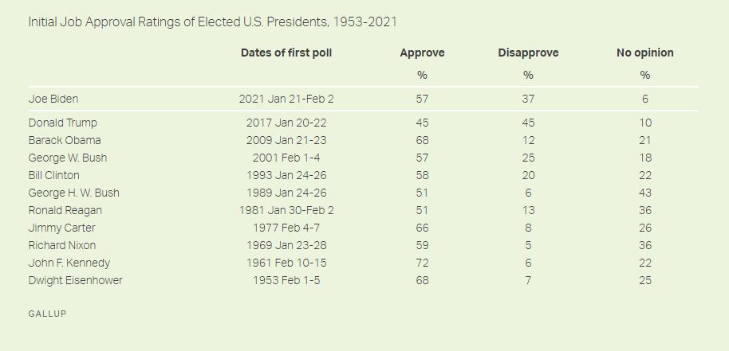
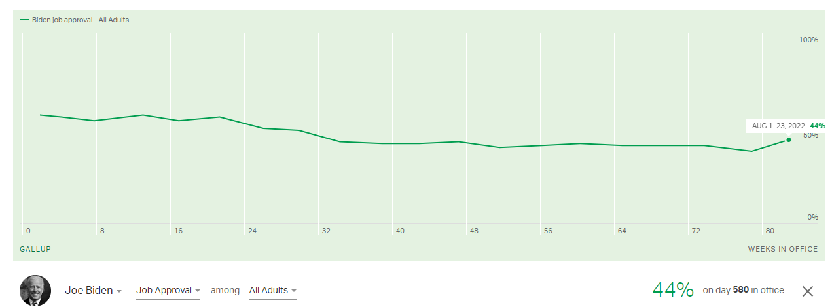
Joe Biden Job Approval
Presidents want to maintain approval numbers above 50%, and Biden’s presidency started at 57%
Biden enjoyed a 6-month honeymoon period, after which his approval numbers have been below 50%
Notes:
Biden Begins Term With 57% Job Approval (gallup.com)
https://news.gallup.com/poll/329348/biden-begins-term-job-approval.aspx
Presidential Job Approval Center (gallup.com) https://news.gallup.com/interactives/185273/presidential-job-approval-center.aspx
Biden in comparison to other presidents in their second year
https://news.gallup.com/poll/468806/biden-averaged-job-approval-second-year.aspx

Slide 22
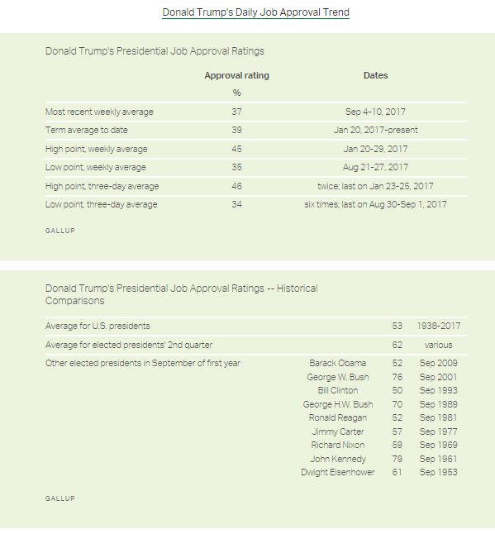
Donald Trump Job Approval Ratings (The Honeymoon Period)
Trump did not enjoy a “honeymoon” as president, averaging only 39% approval of the public in his first 9 months in office
Typically, presidents enjoy a “honeymoon” period when they first take office, meaning that the American people want the new president to get off to a good start and the president’s political opposition usually stands down for a while
Notes:
Source: http://news.gallup.com/poll/203198/presidential-approval-ratings-donald-trump.aspx
Like Trump, Bill Clinton did not have a good “honeymoon” period. Though, Clinton’s approval numbers were better than Trump’s at the same point in their presidency. Clinton approval rating was 50% in September of his first year, compared to Trump’s ~35% approval.

Slide 23
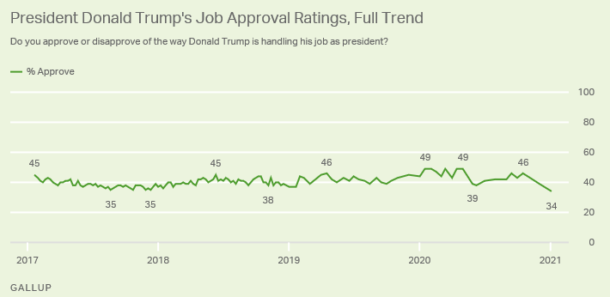
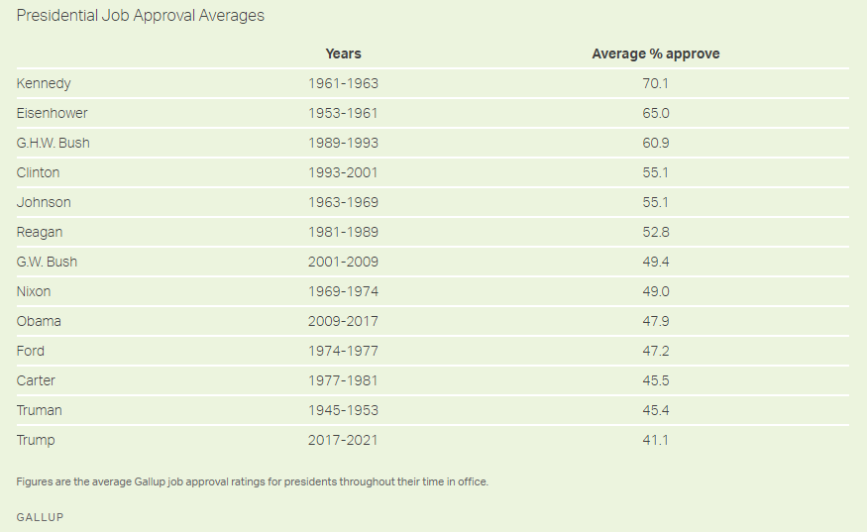
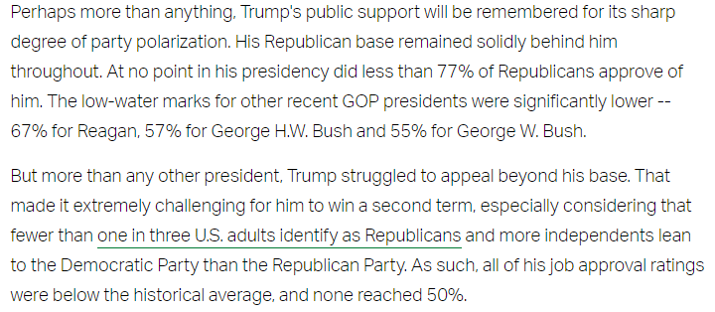
Donald Trump Job Approval Rating (2017-21)
President Trump’s job approval never exceeded 50%, the only president not to have. Trump’s style was so different, being very combative with both friends and foes, and this may have contributed to his historically low numbers
The Gallup Poll’s Explanation
Trump’s average job approval rating of 41% was lower than all other modern presidents
Notes:
Last Trump Job Approval 34%; Average Is Record-Low 41% (gallup.com)
https://news.gallup.com/poll/328637/last-trump-job-approval-average-record-low.aspx

Slide 24
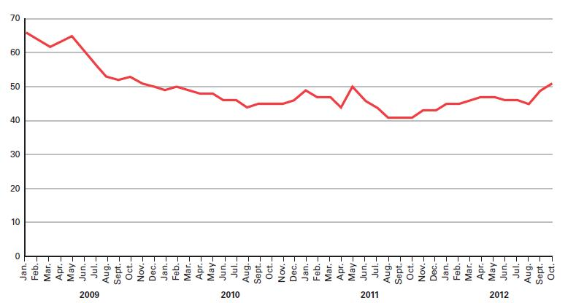
Barack Obama Job Approval Ratings (2009-17)
Presidents want to maintain approval numbers above 50%, but throughout most of Obama’s first term, his numbers were below 50%--this is the effect of a sluggish economy (and a controversial and unpopular health care proposal)

Slide 25
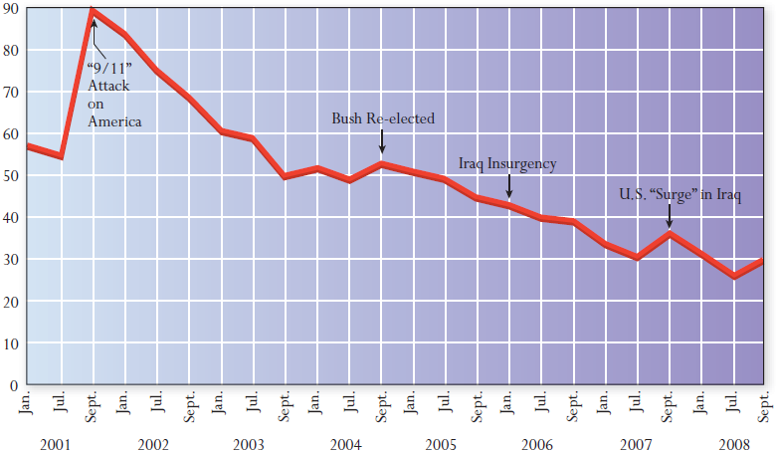
George W. Bush Job Approval Ratings (2001-09)
Notice the “rally effect” associated with the 9/11 terrorist attacks
Much of the drop in Bush’s ratings was the result of the Iraq War
In most cases across US history, war has been devastating to wartime presidents
Notes:
Bush43 was hurt very badly, politically, for fighting the Iraq War. Obama was not hurt by war, however. He withdrew U.S. troops from Iraq in 2011, though some military advisors and special forces were reinstated later in 2014, after ISIS captured territory across Syria and Iraq.

Slide 26
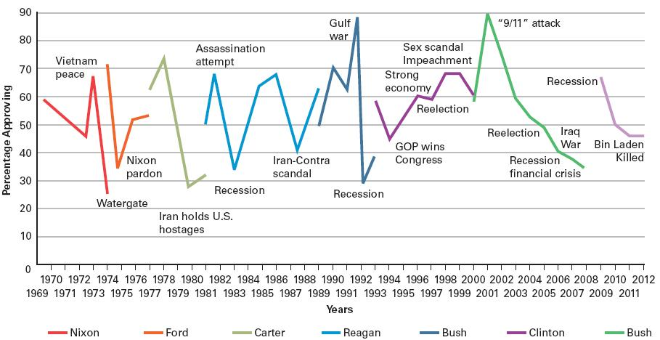
Public Opinion War, Economy, & Scandal
Notes:
Scandals usually hurt a president’s standing with the public. Notice how Watergate hurt Nixon’s poll numbers, how the Iran Hostage crisis damaged Carter’s, and how the Iran-Contra scandal adversely affected Reagan’s, but look how the public rallied around Bill Clinton during the Monica Lewinsky scandal. Clinton was the exception to that rule—that scandals damage a president’s standing with the public.
Clinton bucked many trends: 1) Clinton did not have a successful honeymoon period (first 6 months in office), but in the long run, a poor honeymoon did not negatively affect his presidency…2) Clinton recovered completely from a major scandal (Monica), went on to fight and win the War in Kosovo and then tried to broker (unsuccessfully) a peace agreement between the Israelis and Palestinians, 3) Clinton finished strong (his presidency); he was never a lame duck (see previous comments on #2), 4) Clinton did not cater to his core ideological base, and he wasn’t hurt by this (but he did give them one important political victory the base demanded, which was an end to the Reagan-Bush era).
Recessions (negative downturns in the economy) usually hurt a president’s standing with the public. See how the 1982 recession hurt Reagan, how the 1991 recession hurt Bush41 (the father), how the 2008-2010 recession hurt both Bush (the son) and Obama.

Slide 27
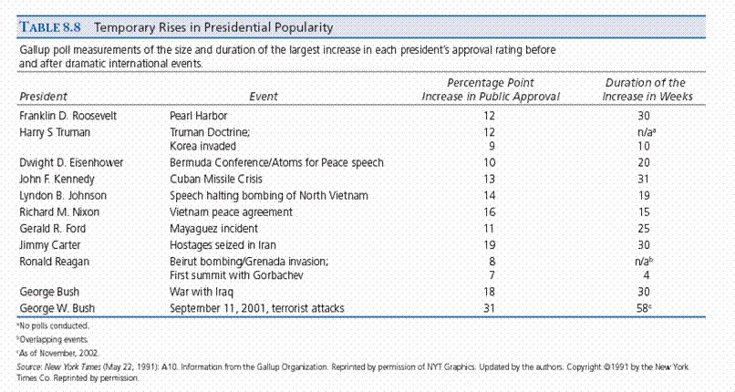
The Rally Effect Foreign Policy and Popularity
Notes:
When there is a foreign policy crisis, even one that goes bad for America (or even one for which the country could plausibly blame the president), the public “rallies” behind the president, at least in the immediate aftermath following the crisis.
Kennedy’s support went up more than 10 point after the Bay of Pigs (not shown in table above). Iran Hostage Crisis improved Carter’s public approval numbers for 8 months before the public began to tire of the crisis and Carter’s numbers subsequently plummeted. Pearl Harbor and 9/11 were disasters for America also, but support for the president in each case increased. This is the “rally around the flag” effect.

